Slide 1

Unlocking Deposit Acceptance: Exploring Key Factors and Recommendations
https://github.com/MuhammedRagabb/Deposit-acceptance-analysis.git

Slide 2

Introduction:
The analysis focuses on understanding the factors that influence deposit
acceptance in the context of a bank's target marketing campaign.
By examining the relationship between specific demographic and financial variables and the likelihood of making a deposit, we aim to gain insights that can inform effective marketing strategies and improve campaign outcomes.

Slide 3

Objectives:
Explore the relationship between marital status and deposit acceptance.
Investigate whether education level is associated with the likelihood of making a deposit.
Assess the impact of housing loan status on deposit acceptance.
Determine if having a personal loan affects the probability of making a deposit.

Slide 4

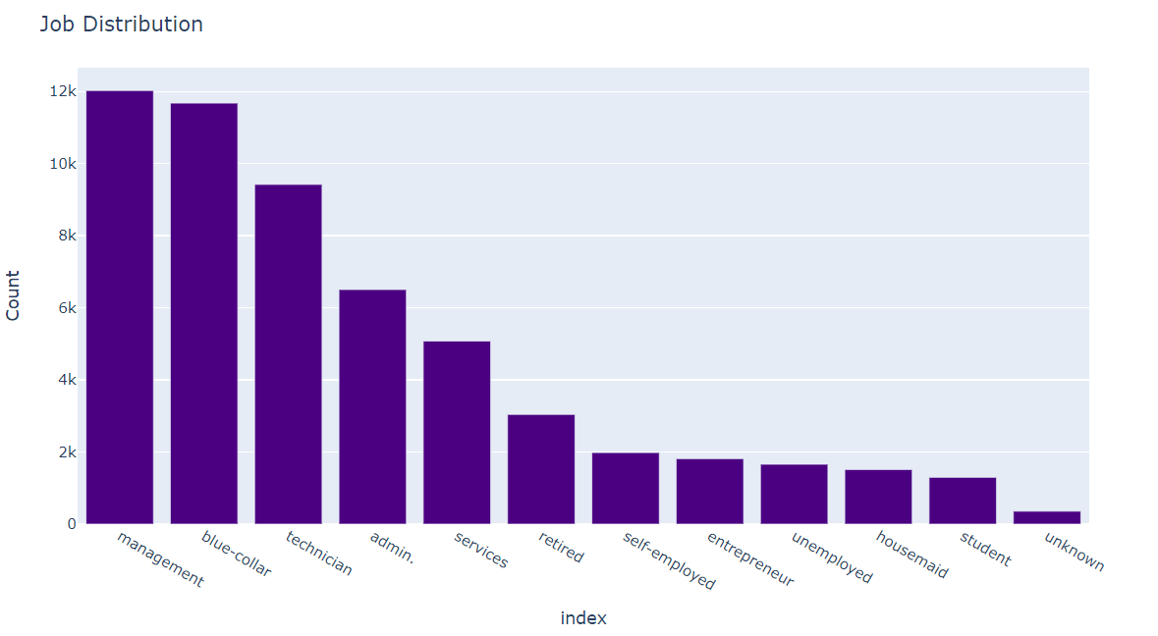
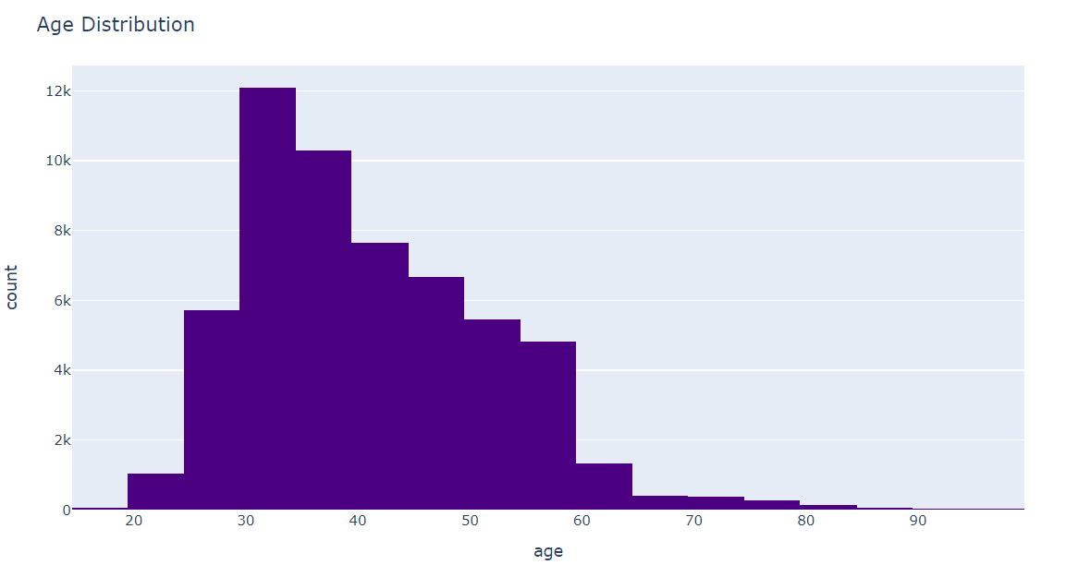
EDA:
Job Distribution:
The Top Three Jobs are:
Management
Blue-collar
Technician
Age Distribution
The most common ages varies between
30 and 40

Slide 5
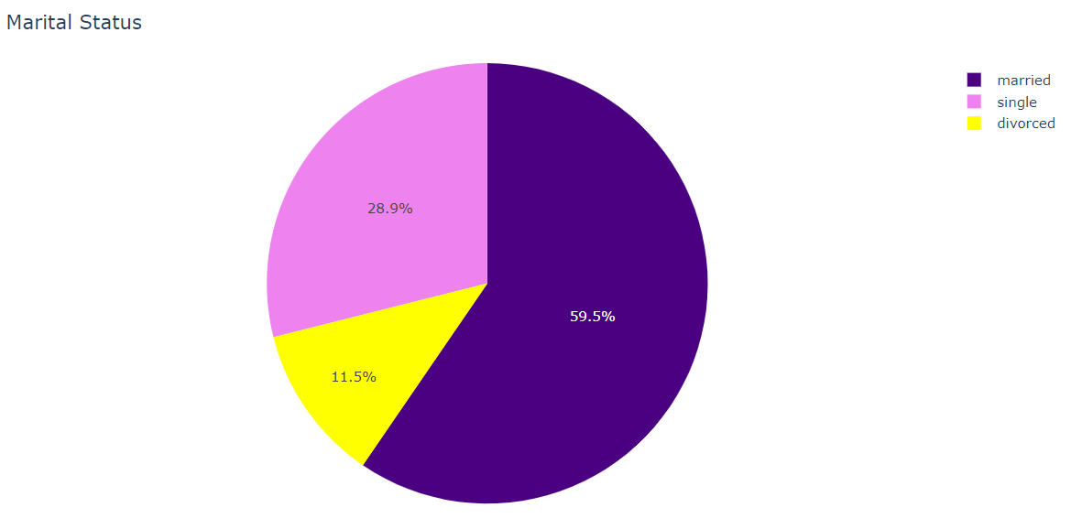
Marital status distribution

Slide 6
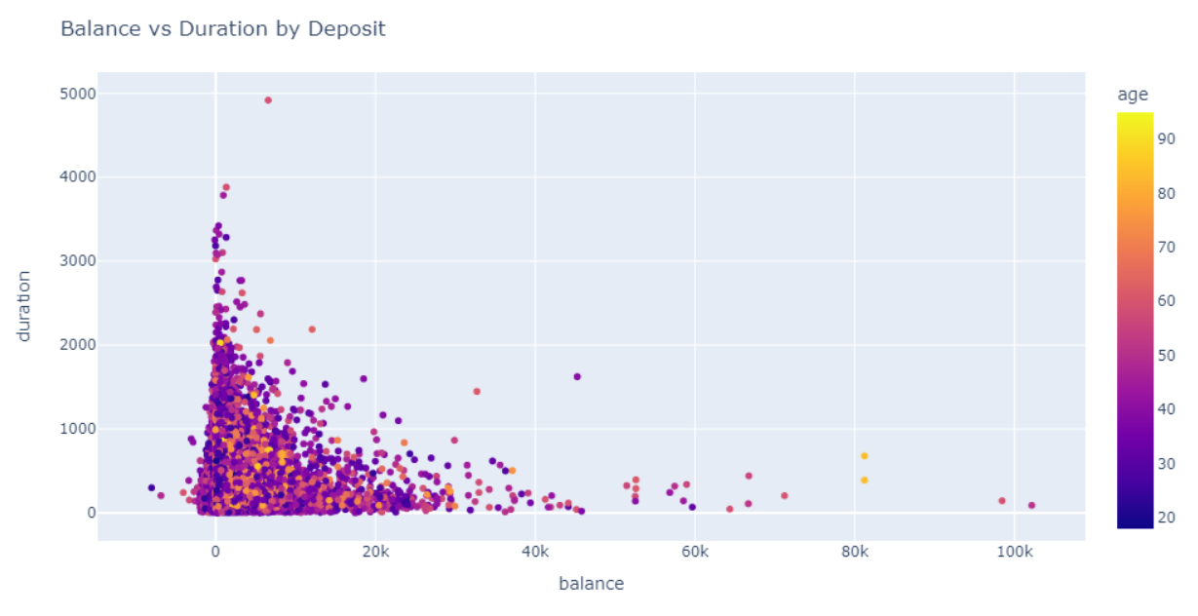
We created a scatter plot to visualize the relationship between "balance" and "duration," with each point colored based on the deposit category.
These visualizations (including the previous two with Job and Age distribution) provide insights into how the deposit feature relates to different variables, such as job, age, balance, and duration. You can customize the plots further based on your specific requirements, such as adding labels and titles.

Slide 7
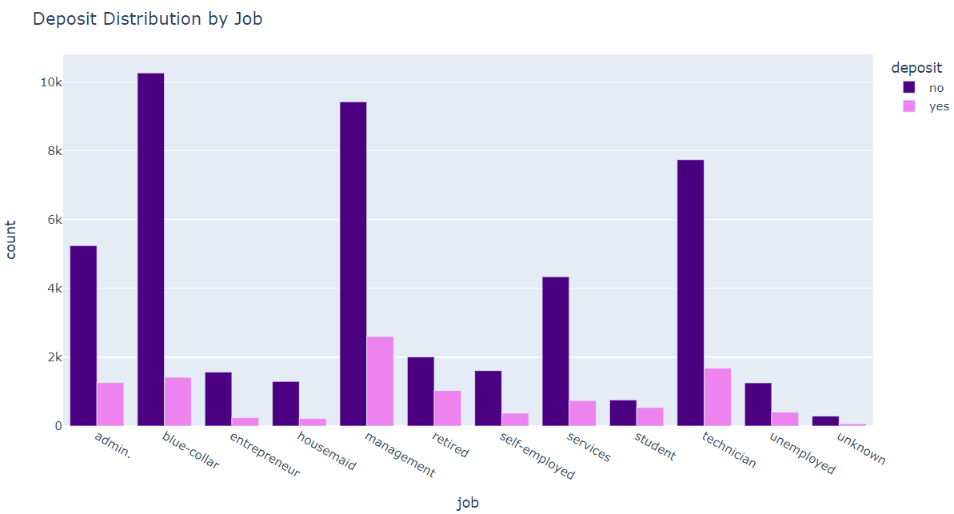
This is how the distribution of deposit differ across different job categories

Slide 8
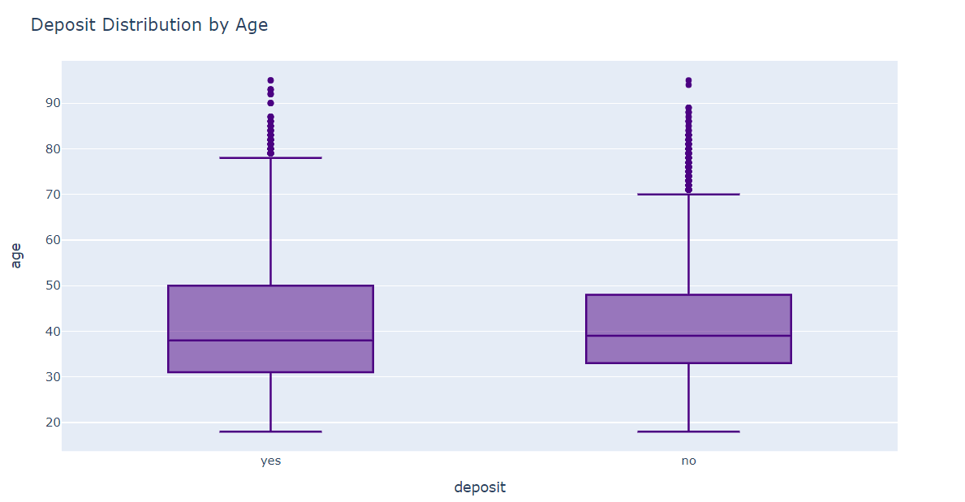
The relationship between age and deposit acceptance:
By examining the box plot, we can observe differences in the median, quartiles,
and outliers between the two groups, which would indicate a potential relationship
between age and deposit acceptance.

Slide 9
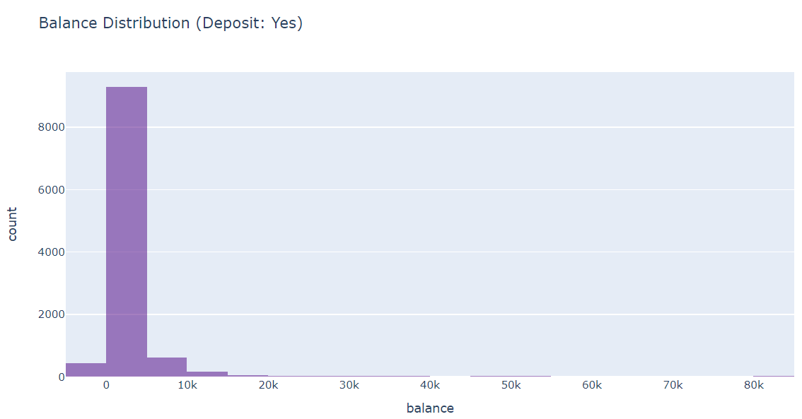
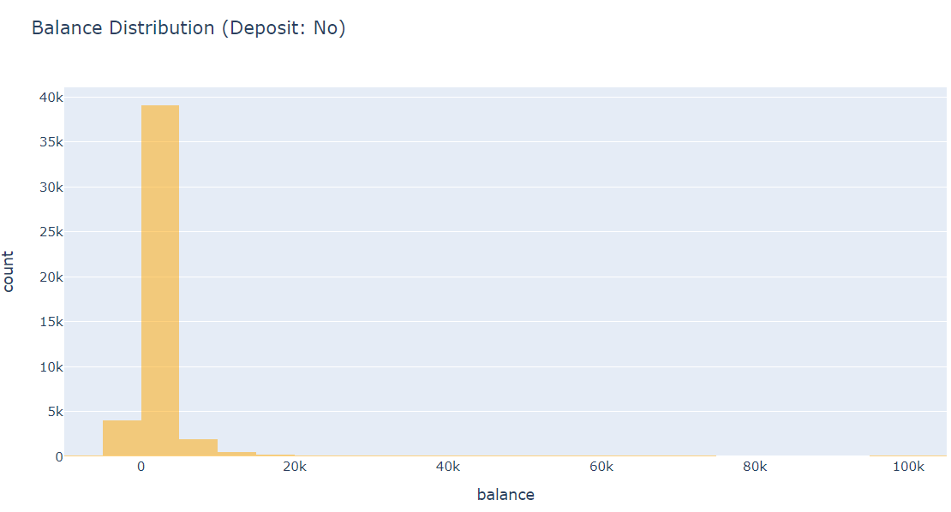
Balance distribution for customers who have and haven't made a deposit
By examining these histogram plots, you can compare the balance distribution
for customers who have and haven't made a deposit.

Slide 10
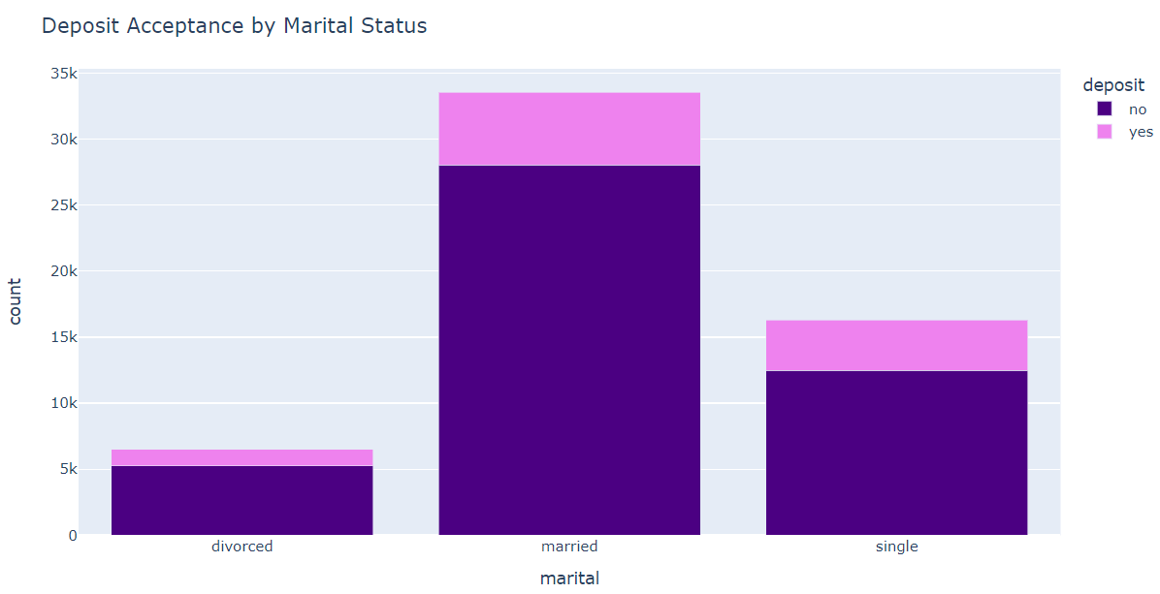
How does marital status relate to deposit acceptance
This stacked bar chart visualizes the distribution of deposit acceptance for each marital status category.
It allows you to compare the proportions of deposit acceptance across different marital statuses and identify any potential relationships between marital status and deposit acceptance.

Slide 11
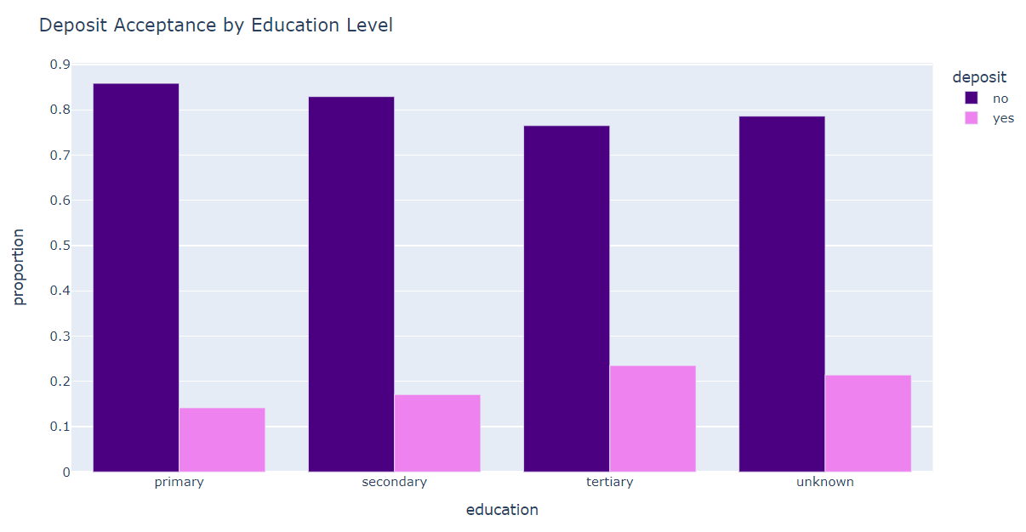
Educational level associated with the likelihood of
making a deposit
We can compare the likelihood of making a deposit across different education levels
and determine if there is an association between education level and deposit acceptance.

Slide 12
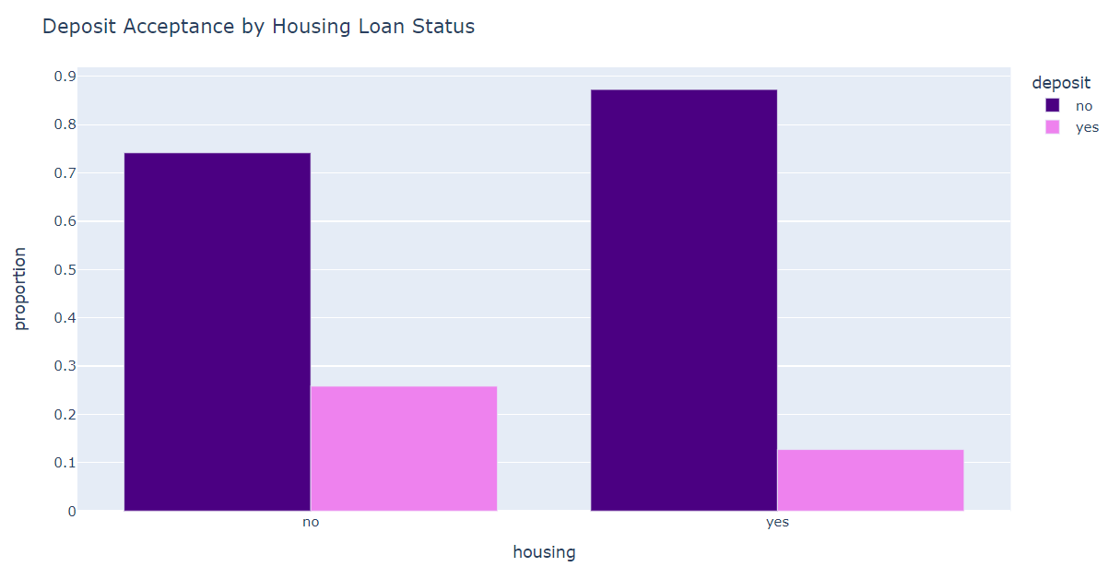
The impact of housing loan status on deposit acceptance
This is represent the proportion of deposit acceptance for customers with and without a housing loan.
It allows us to compare the impact of housing loan status on deposit acceptance
and determine if there is a relationship between the two variables.

Slide 13
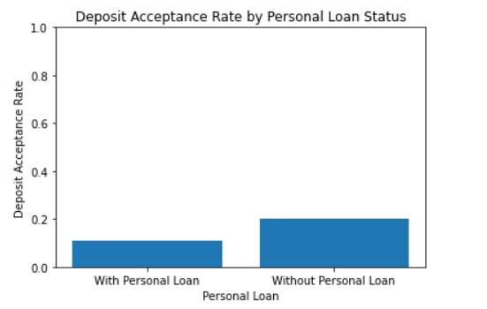
Having a personal loan effect on the probability of making a deposit
These rates represent the probability of making a deposit for each group.
By comparing these rates, we can determine if having a personal loan
has an impact on the likelihood of making a deposit.

Slide 14
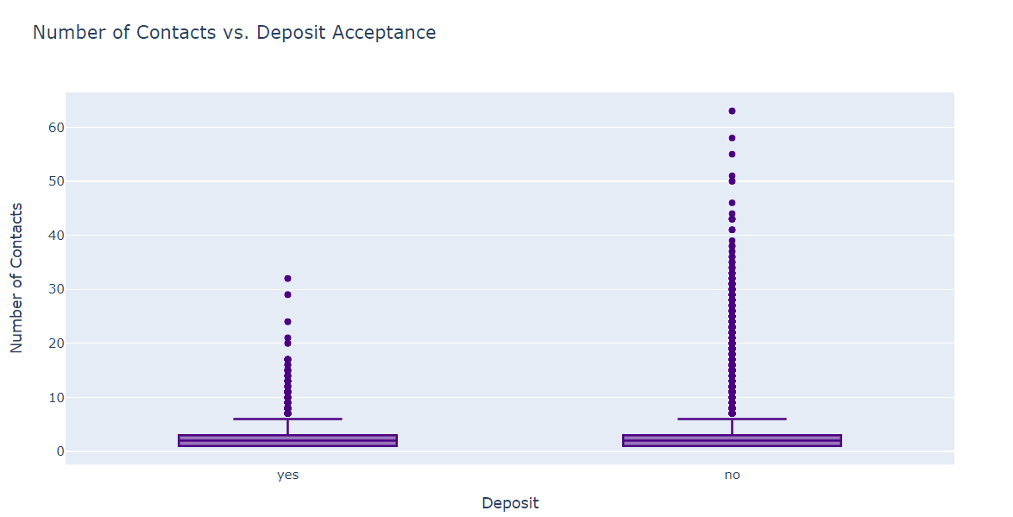
The Relationship between the number of contacts and deposit acceptance

Slide 15

Recommendations:
Marital Status vs. Deposit Acceptance:
Highlight the importance of marital status as a contributing factor in deposit acceptance.
Tailor marketing strategies accordingly by understanding the preferences and needs of different marital status groups.
Consider offering targeted financial products or incentives to specific marital status segments to increase deposit acceptance rates.
Education Level vs. Deposit Acceptance:
Recognize the influence of education level on deposit acceptance and customer behavior.
Create educational materials and resources to address the financial needs and concerns of different education levels.
Develop personalized marketing campaigns that resonate with individuals based on their educational background.
Recommendations:
3. Housing Loan vs. Deposit Acceptance:
Highlight the impact of housing loan status on deposit acceptance rates.
Explore the potential of offering tailored savings plans or investment options to customers with housing loans.
Consider providing financial counseling or assistance to customers with housing loans to build trust and encourage deposit acceptance.
4. Personal Loan vs. Deposit Acceptance:
Emphasize the relationship between personal loans and deposit acceptance.
Offer targeted promotions or incentives to customers with personal loans to encourage deposit behavior.
Provide comprehensive financial advice and solutions that consider the specific circumstances of individuals with personal loans.

